Slide 1
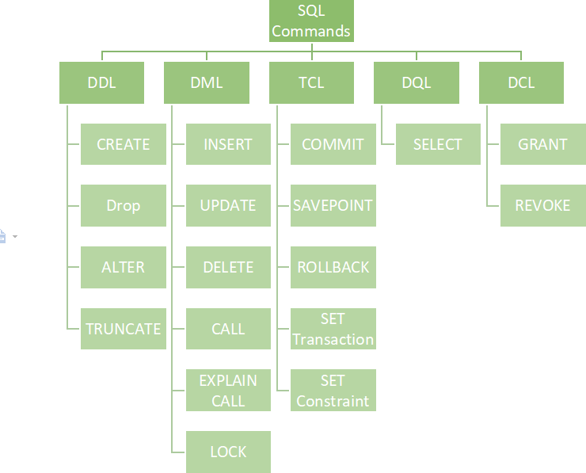
STRUCTURE QUERY LANGUAGE
Pooja Patil
Batch Code:7670
SQL: Structured Query Language(SQL) as we all know is the database language by the use of which we can perform certain operations on the existing database and also we can use this language to create a database. SQL uses certain commands like Create, Drop, Insert, etc. to carry out the required tasks.
These SQL commands are mainly categorized into four categories as:
DDL – Data Definition Language
DQl – Data Query Language/ DRL Data Retrieval Language
DML – Data Manipulation Language
DCL – Data Control Language
Though many resources claim there to be another category of SQL clauses TCL – Transaction Control Language. So we will see in detail about TCL as well.
DDL (Data Definition Language):

Slide 2
STRUCTURE QUERY LANGUAGE
DDL or Data Definition Language actually consists of the SQL commands that can be used to define the database schema. It simply deals with descriptions of the database schema and is used to create and modify the structure of database objects in the database. DDL is a set of SQL commands used to create, modify, and delete database structures but not data. These commands are normally not used by a general user, who should be accessingthe database via an application.
List of DDL commands:
CREATE: This command is used to create the database or its objects (like table, index, function, views, store procedure, and triggers).
DROP: This command is used to delete objects from the database.
ALTER: This is used to alter the structure of the database.
TRUNCATE: This is used to remove all records from a table, including all spaces allocated for the records are removed.
COMMENT: This is used to add comments to the data dictionary.
RENAME: This is used to rename an object existing in the database.
DQL (Data Query Language): Data Retrieval language.
DQL statements are used for performing queries on the data within schema objects. The purpose of the DQL Command is to get some schema relation based on the query passed to it. We can define DQL as follows it is a component of SQL statement that allows getting data from the database and imposing order upon it. It includes the SELECT statement. This command allows getting the data out of the database to perform operations with it. When a SELECT is fired against a table or tables the result is compiled into a further temporary table, which is displayed or perhaps received by the program i.e. a front-end.
List of DQL:
SELECT: It is used to retrieve data from the database.
DML(Data Manipulation Language):
The SQL commands that deals with the manipulation of data present in the database belong to DML or Data Manipulation Language and this includes most of the SQL statements. It is the component of the SQL statement that controls access to data and to the database. Basically, DCL statements are grouped with DML statements.
List of DML commands:
INSERT : It is used to insert data into a table.
UPDATE: It is used to update existing data within a table.
DELETE : It is used to delete records from a database table.
LOCK: Table control concurrency.
CALL: Call a PL/SQL or JAVA subprogram.
EXPLAIN PLAN: It describes the access path to data.
DCL (Data Control Language):
DCL includes commands such as GRANT and REVOKE which mainly deal with the rights, permissions, and other controls of the database system.
List of DCL commands:
GRANT: This command gives users access privileges to the database.

Slide 3
STRUCTURE QUERY LANGUAGE
REVOKE: This command withdraws the user’s access privileges given by using the GRANT command.
Though many resources claim there to be another category of SQL clauses TCL –
Transaction Control Language. So we will see in detail about TCL as well. TCL commands deal with the transaction within the database.
List of TCL commands:
COMMIT: Commits a Transaction.
ROLLBACK: Rollbacks a transaction in case of any error occurs.
SAVEPOINT:Sets a savepoint within a transaction.
SET TRANSACTION: Specify characteristics for the transaction.
https://www.oracle.com/database/technologies/xe-prior-release-downloads.html
https://youtu.be/seFRL1GAzLY https://www.testingdocs.com/download-install-mysql-on-windows-11/
https://dev.mysql.com/downloads/installer/ https://youtu.be/eq-e_n7lm2M
https://www.youtube.com/watch?v=WuBcTJnIuzo https://www.youtube.com/watch?v=wEHWYuzP7VE

Slide 4
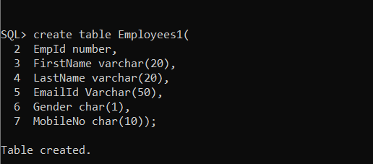

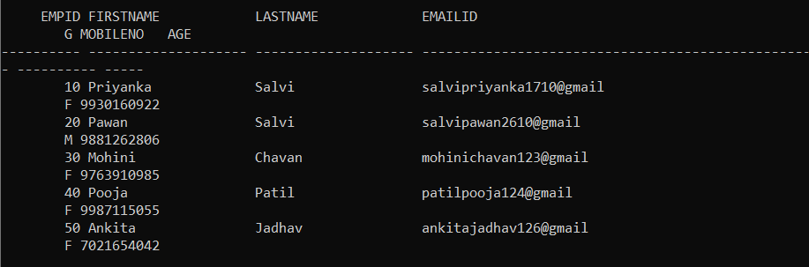
DDL (Data Definition Language)
STRUCTURE QUERY LANGUAGE
Create:
Syntax : create table tablename(col1 datatype,col2 datatype,….);
EX: create table Employees1(EmpId number, FirstName varchar(20), LastName varchar(20), EmailId Varchar(50), Gender char(1), MobileNo char(10));
Alter:
Syntax: ALTER TABLE table_name
ADD new_column_name column_definition Example: alter table Employees1 add Age varchar(5);
Rename:
Syntax: rename Old _table To New_table;

Slide 5
STRUCTURE QUERY LANGUAGE
Example: rename employees1 To customer;

Slide 6

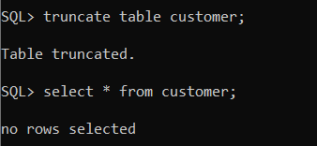
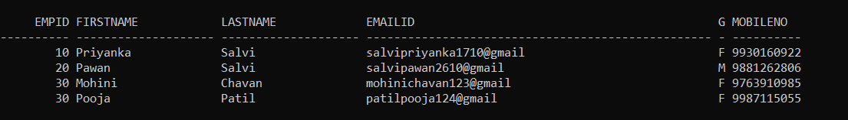
STRUCTURE QUERY LANGUAGE
Truncate
Syntax: Truncate table table_name; Example: Truncate table Customer;
DQL (Data Query Language)
Select:
Syntax: select * from table name; Example: select * from Employees1;
`
DML(Data Manipulation Language)
1. Insert
Syntax: INSERT INTO table_name (column_1, column_2, column_n) VALUES (expression_1, expression_2, ... expression_n)

Slide 7
STRUCTURE QUERY LANGUAGE
Example: insert into Employees1 (EmpId, FirstName,LastName,EmailId, Gender, MobileNo) values (010, 'Mohini', 'Chavan', 'chavanmohini@gmail', 'F', 9930160922);

Slide 8
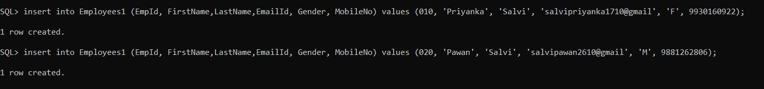
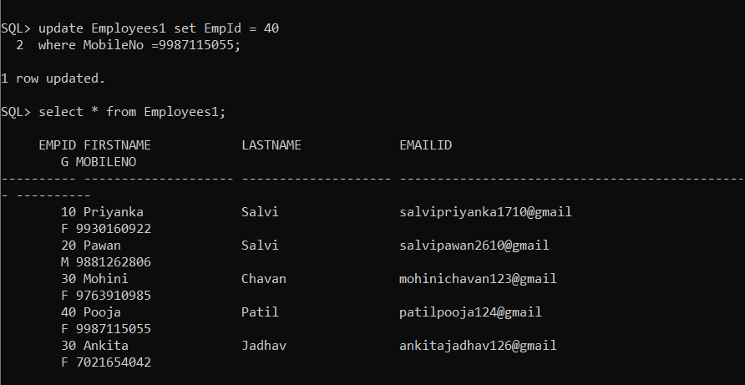
STRUCTURE QUERY LANGUAGE
2. Update:
Syntax: PDATE table1
SET column1 = (SELECT expression1 FROM table2
WHERE conditions)
Example: update Employees1 set EmpId = 40 where MobileNo =9987115055;

Slide 9
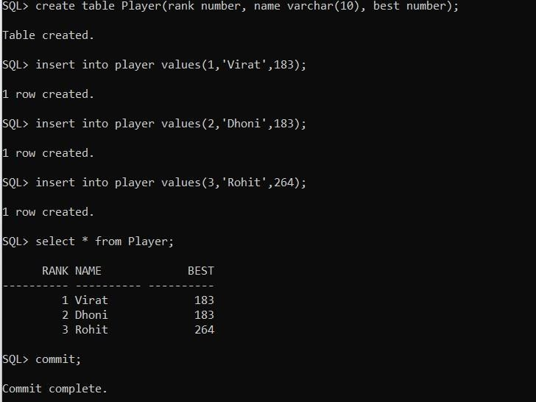
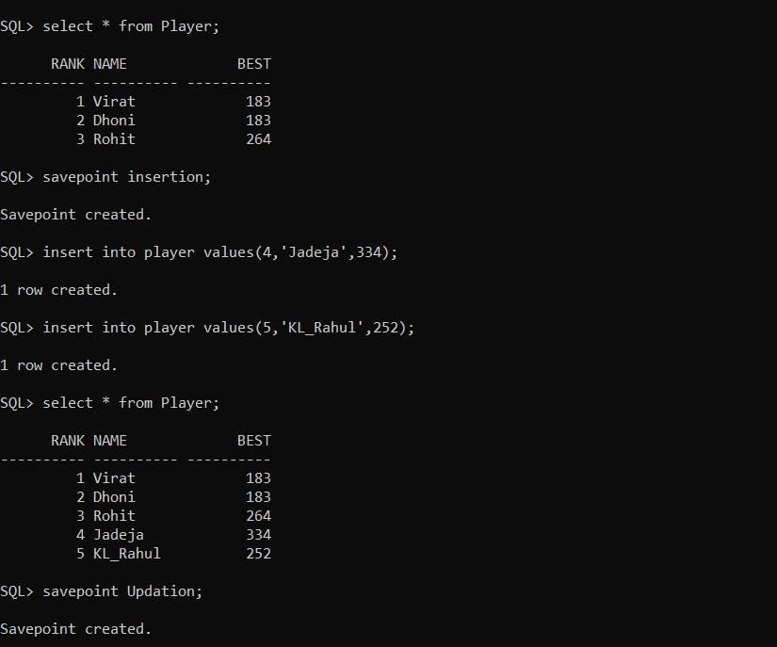
TCL (Transaction Control Language)
STRUCTURE QUERY LANGUAGE
3. Commit:
Syntax: commit;
4. Savepoint:
Syntax: savepoint_name ;

Slide 10
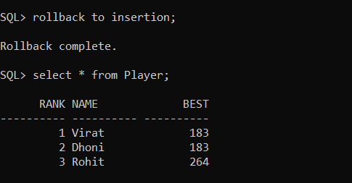
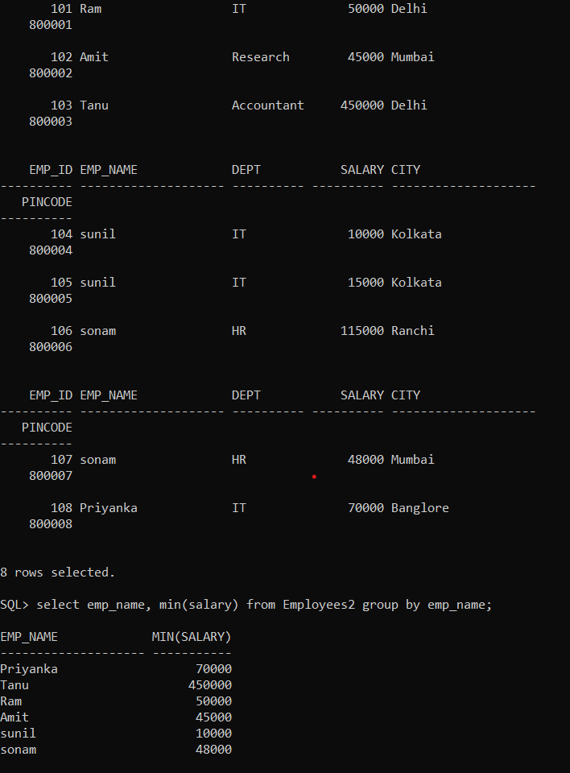
STRUCTURE QUERY LANGUAGE
5. Rollback:
Syntax: Rollback to savepoint_name;
GROUP BY:
Syntax: SELECT column_name(s) FROM table_name
WHERE condition
GROUP BY column_name(s) ORDER BY column_name(s);

Slide 11
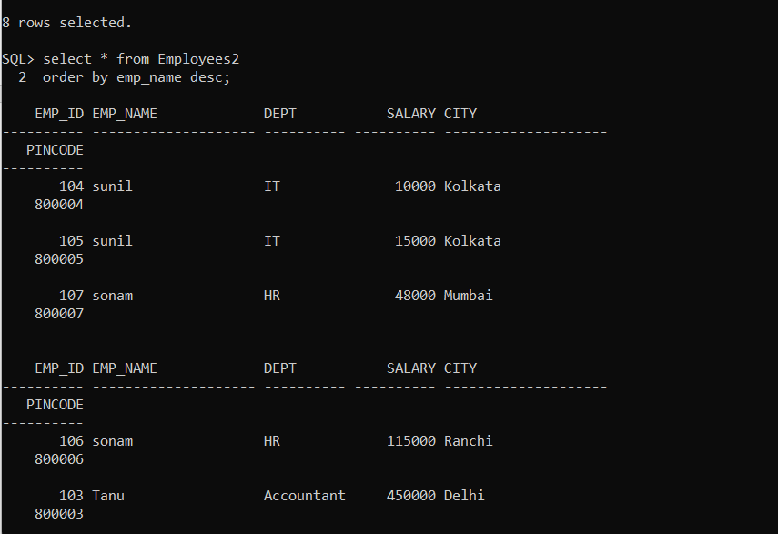
STRUCTURE QUERY LANGUAGE
ORDER BY :
Syntax:
SELECT column1, column2, ... FROM table_name
ORDER BY column1, column2, ... ASC|DESC;

Slide 12
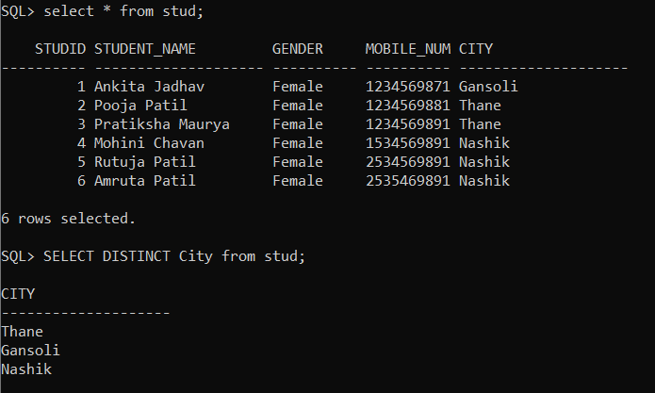
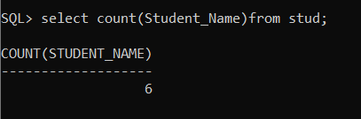
STRUCTURE QUERY LANGUAGE
SQL SELECT:
1. SQL SELECT DISTINCT:
Syntax: select distinct column_name from table_name; Example: SELECT DISTINCT City from stud;
2. SQL SELECT COUNT
Syntax: select count(column_name)from table_name; Example: select count(Student_Name)from stud;
6. COUNT FUNCTION WITH WHERE CLAUSE IN SQL:
Syntax: SELECT COUNT(column_name) FROM (table_name )WHERE (column_name)condition;

Slide 13
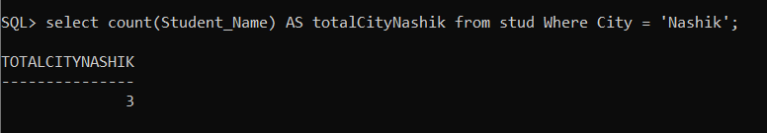
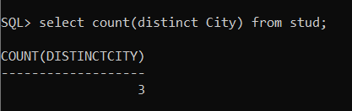
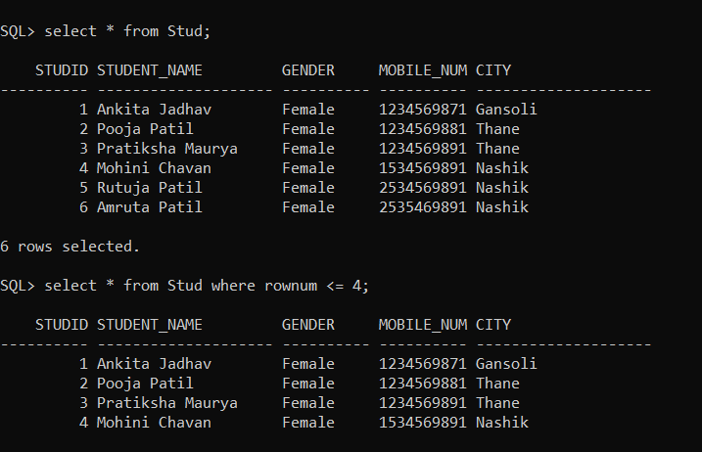
STRUCTURE QUERY LANGUAGE
Example: select count(Student_Name) AS totalCityNashik from stud Where City = 'Nashik';
7. COUNT FUNCTION WITH DISTINCT KEYWORD
Syntax: select count(distinct column_name) from table_name where (condition); Example:
3. ROWNUM KEYWORD IN WHERE CLAUSE :
Syntax: SELECT column_Name1,column_Name2, ..... , column_NameN FROM table_name WHERE ROWNUM <= value;

Slide 14
STRUCTURE QUERY LANGUAGE
SQL SELECT RANDOM: Syntax: SELECT column FROM (SELECT column FROM table
ORDER BY dbms_random.value) WHERE rownum =1
SQL SELECT SUM:
Syntax: SELECT SUM (expression) FROM tables
WHERE conditions;

Slide 15
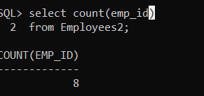
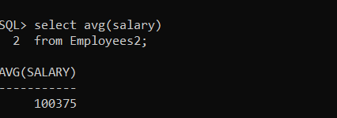
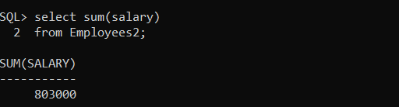
STRUCTURE QUERY LANGUAGE
SQL COUNT(), AVG() AND SUM() FUNCTIONS:
1. COUNT():
Syntax: SELECT COUNT(column_name) FROM table_name
WHERE condition;
2. AVG():
Syntax: SELECT AVG(column_name) FROM table_name
WHERE condition;
3. SUM()
Syntax: SELECT AVG(column_name) FROM table_name;

Slide 16
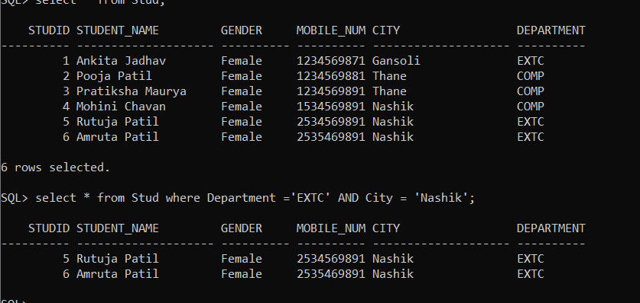
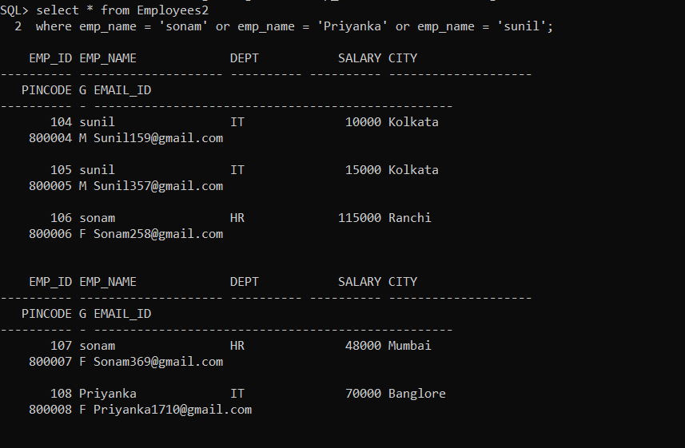
STRUCTURE QUERY LANGUAGE
SQL LOGICAL OPERATOR:
1. SQL AND
Syntax: SELECT * FROM tables _name
WHERE condition 1 AND condition 2;
2. SQL OR:
Syntax: SELECT * FROM tables _name
WHERE condition 1 OR condition 2;

Slide 17
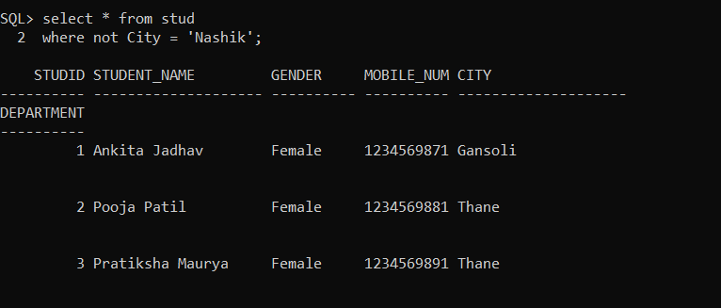
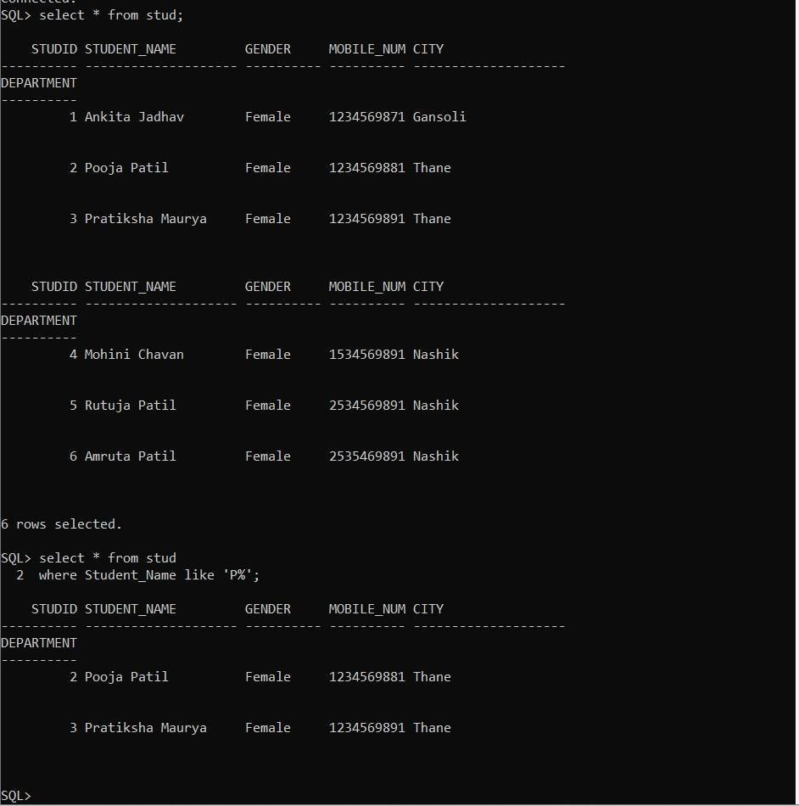
STRUCTURE QUERY LANGUAGE
3. SQL NOT:
Syntax: : SELECT * FROM tables _name
WHERE condition 1 OR condition 2;
4. Like:
Syntax:
SELECT * FROM Customers WHERE CustomerName LIKE 'a%';

Slide 18
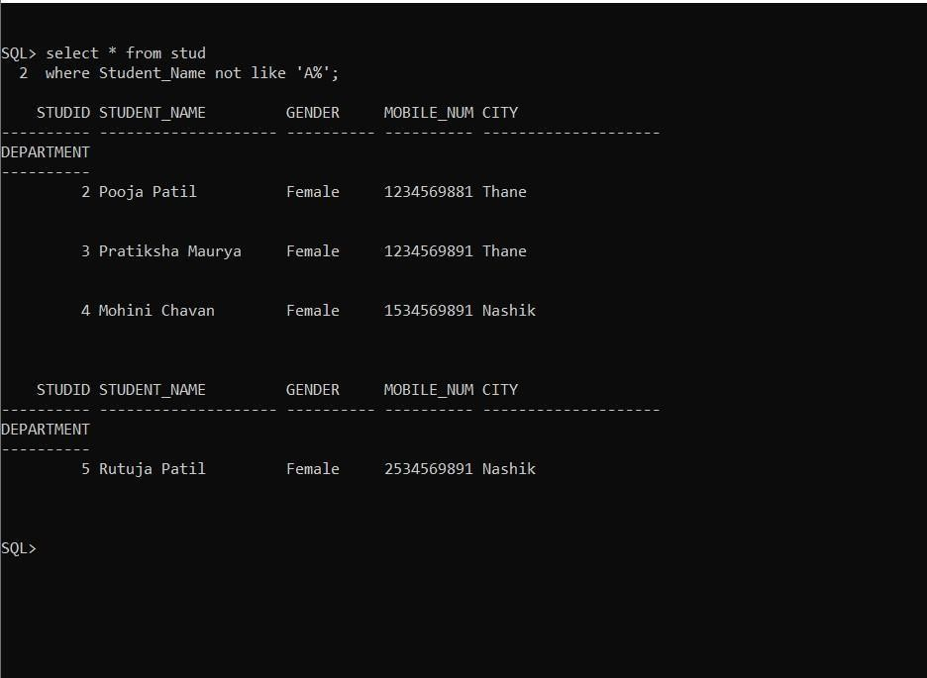
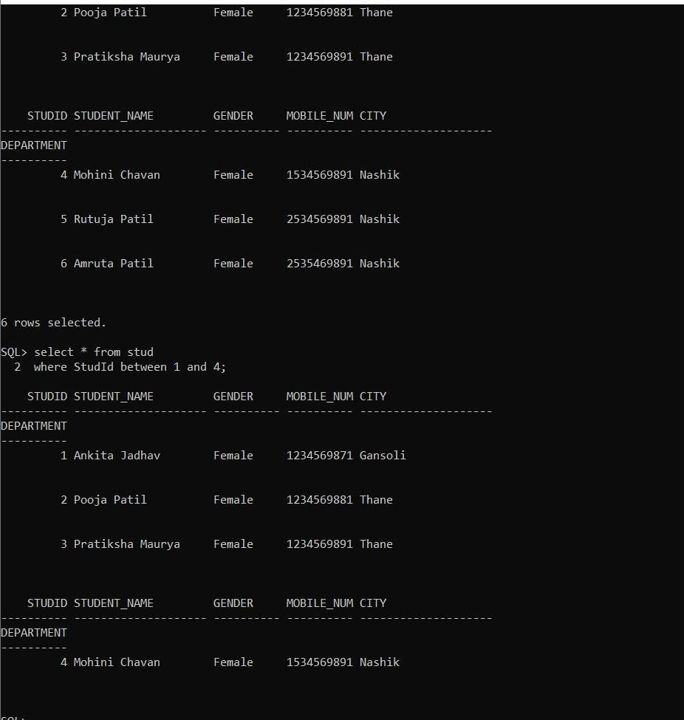
STRUCTURE QUERY LANGUAGE
5. Not Like:
Syntax:
SELECT * FROM Customers
WHERE CustomerName NOT LIKE 'a%';
6. Between:
SELECT column_name(s) FROM table_name
WHERE column_name BETWEEN value1 AND value2;

Slide 19
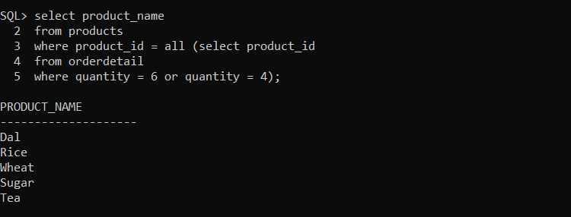
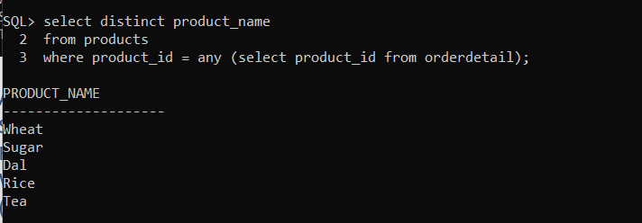
STRUCTURE QUERY LANGUAGE
7. All :
Syntax: SELECT column_name(s) FROM table_name
WHERE column_name comparison_operator ALL (SELECT column_name
FROM table_name WHERE condition(s));
8. Any:
Syntax: SELECT column_name(s) FROM table_name
WHERE column_name comparison_operator ANY (SELECT column_name
FROM table_name WHERE condition(s));

Slide 20
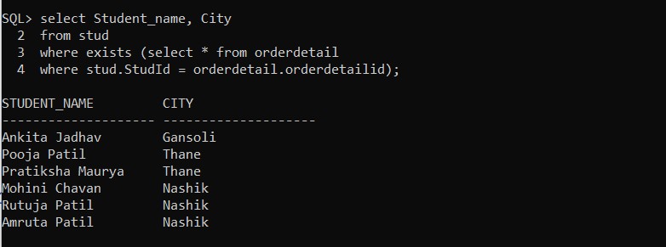
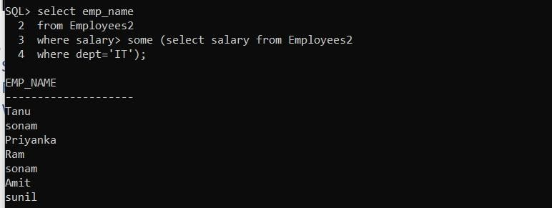
STRUCTURE QUERY LANGUAGE
9. Exists:
Syntax: SELECT column_name(s) FROM table_name
WHERE EXISTS
(SELECT column_name(s) FROM table_name WHERE condition);
10. Some:
Syntax: SELECT column_name(s) FROM table_name
WHERE expression comparison_operator SOME (subquery)

Slide 21
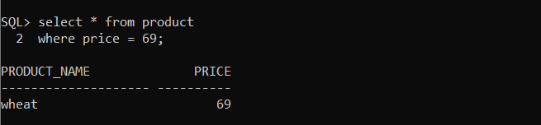
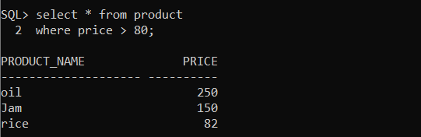
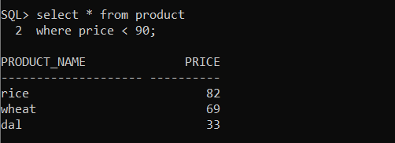
STRUCTURE QUERY LANGUAGE
SQL COMPARISION OPERATORS:
1. Equal to:
Syntax: select * from table_name
Where column_name [comparision operator] <expression>;
2. Greater than (>):
Syntax: select * from table_name
Where column_name [comparision operator] <expression>;
3. Less than (<):
Syntax: select * from table_name
Where column_name [comparison operator] <expression>;

Slide 22
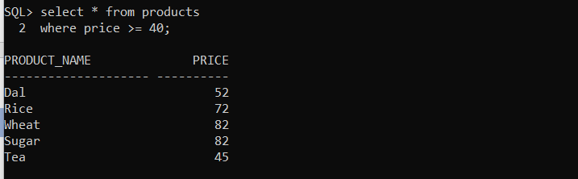
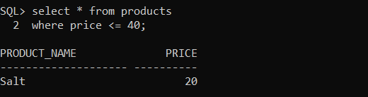
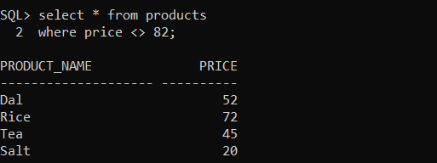
STRUCTURE QUERY LANGUAGE
4. Greater than or equal to (>=):
Syntax: select * from table_name
Where column_name [comparison operator] <expression>;
5. Less than or equal to (<=):
Syntax: select * from table_name
Where column_name [comparison operator] <expression>;
6. Not equal to (<>):
Syntax: select * from table_name
Where column_name [comparison operator] <expression>;

Slide 23
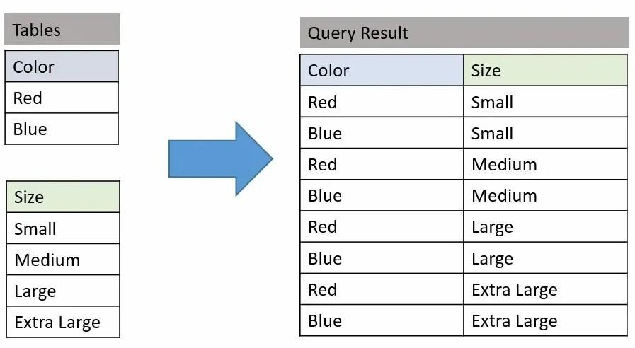
STRUCTURE QUERY LANGUAGE
SQL JOINS
1. Cross join:
Syntax: SELECT TableName1.columnName1, TableName2.columnName2 FROM TableName1 CROSS JOIN TableName2 ON TableName1.ColumnName = TableName2.ColumnName;
2. Inner join:
Syntax: SELECT column_name(s) FROM table1
INNER JOIN table2
ON table1.column_name = table2.column_name;

Slide 24
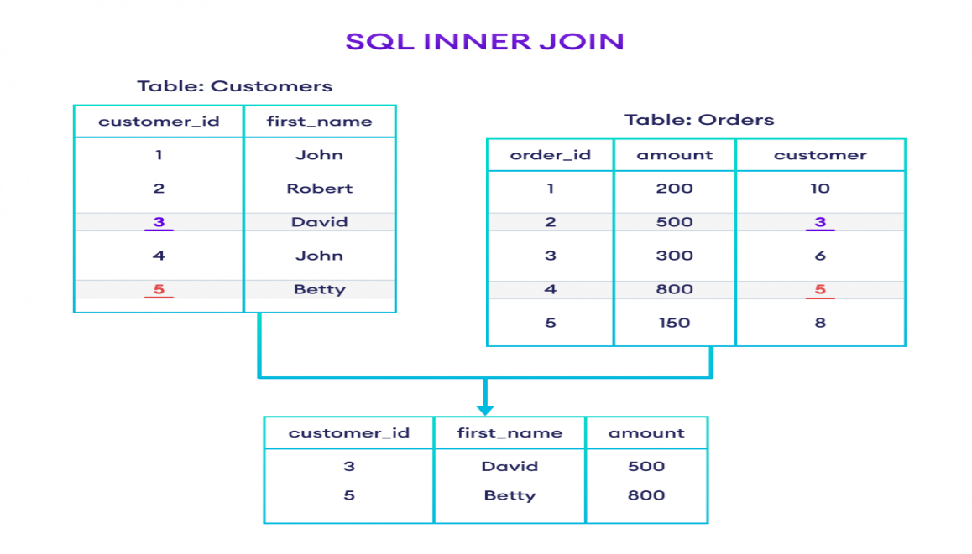
STRUCTURE QUERY LANGUAGE

Slide 25
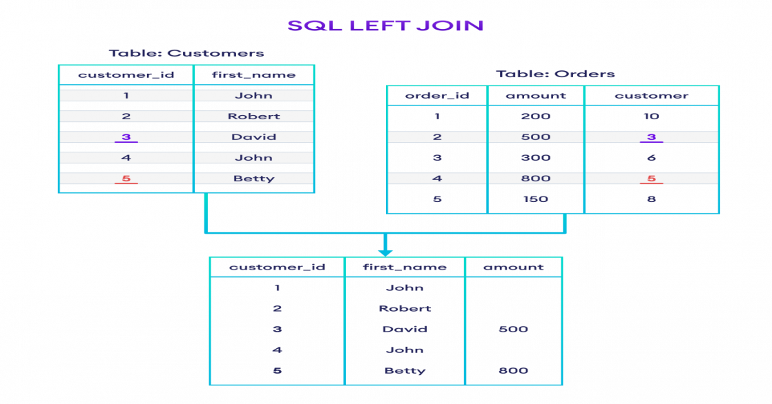
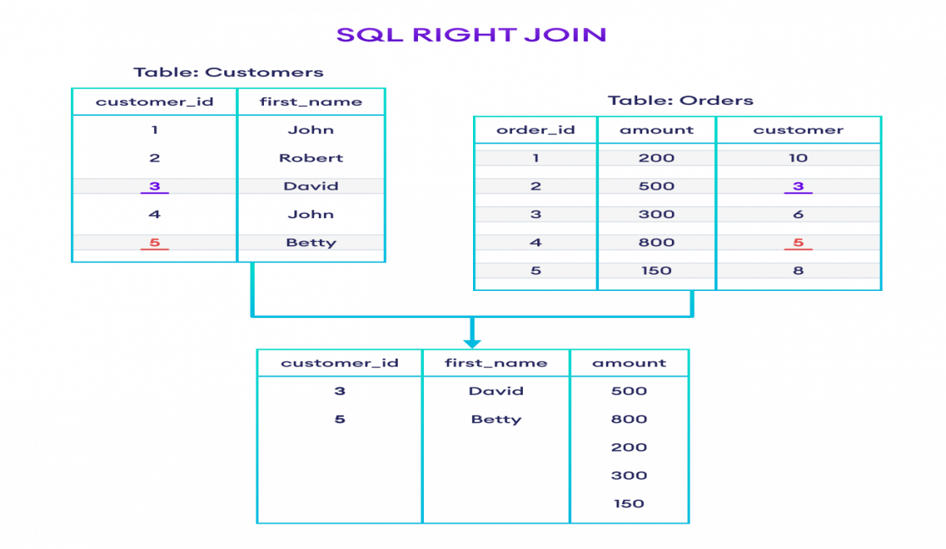
STRUCTURE QUERY LANGUAGE
3. Outer left join:
Syntax: SELECT table1.column1, table2.column2.... FROM table1
LEFTJOIN table2
ON table1.column_field = table2.column_field;
4. Outer right join:
Syntax: SELECT table1.column1, table2.column2..... FROM table1
RIGHT JOIN table2
ON table1.column_field = table2.column_field;

Slide 26
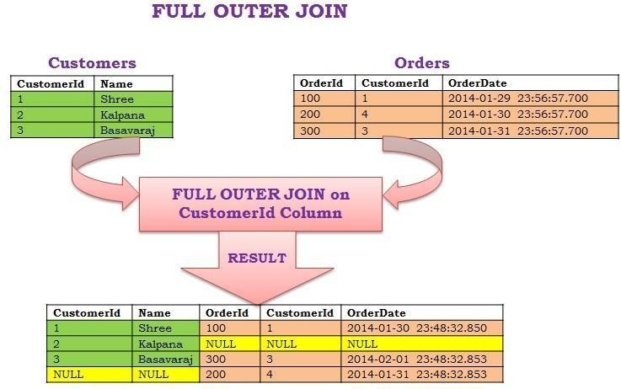
STRUCTURE QUERY LANGUAGE
5. Outer full join: Syntax: SELECT * FROM table1
FULL OUTER JOIN table2
ON table1.column_name = table2.column_name;

Slide 27
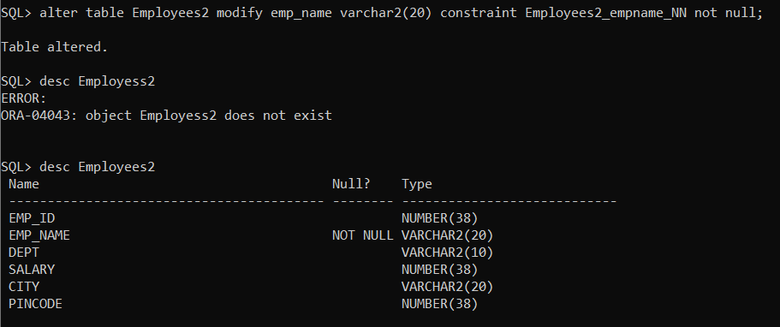
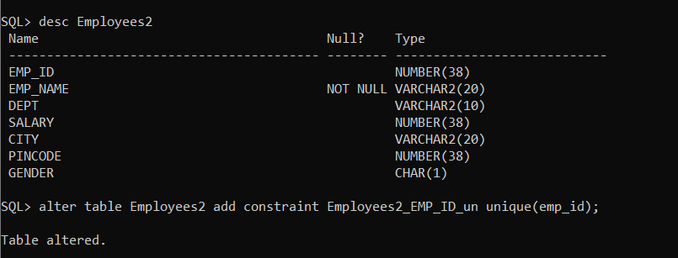
STRUCTURE QUERY LANGUAGE
SQL CONSTRAINTS:
1. Not Null : Syntax:
ALTER TABLE Persons
MODIFY COLUMN Age int NOT NULL;
2. Unique constraints:
Syntax:
ALTER TABLE table_name
ADD CONSTRAINT unique_constraint_name UNIQUE(column_name1, column_nam2);
3. Check constraints:
Syntax: alter table table_name

Slide 28
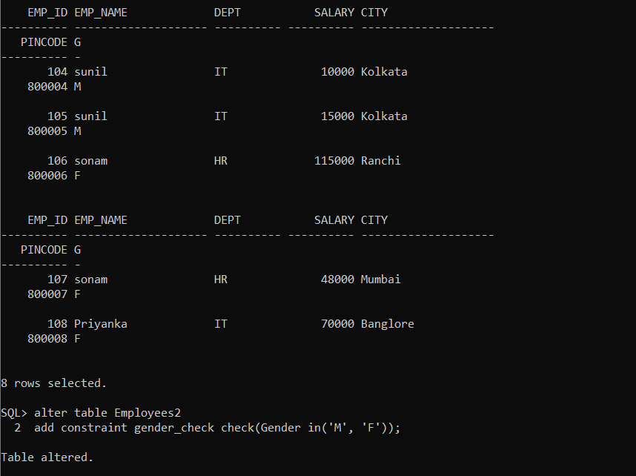
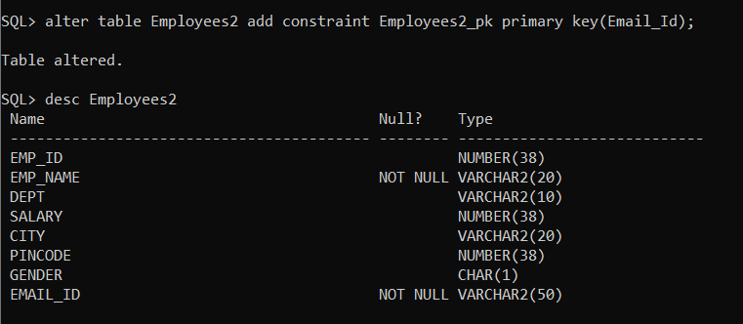
STRUCTURE QUERY LANGUAGE
Add constraint column_name_check check (column_name in (condition));
4. Primary Key:
Syntax:
ALTER TABLE table_name
ADD CONSTRAINT constraint_name PRIMARY KEY (column1, column2, ... column_n);
5. Foreign key :
Syntax: ALTER TABLE table_name ADD CONSTRAINT constraint_name
FOREIGN KEY (column1, column2, ... column_n)
REFERENCES parent_table (column1, column2, ... column_n);

Slide 29
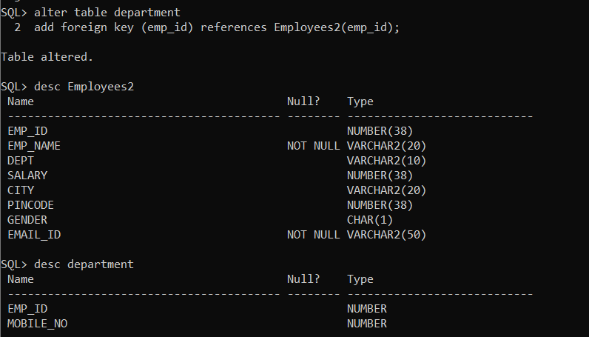
STRUCTURE QUERY LANGUAGE

